Slide 1
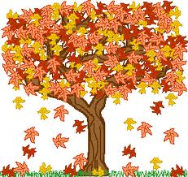
All the leaves are
Falling down

Slide 2
Orange

Slide 3
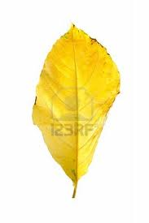
Yellow

Slide 4
Red

Slide 5
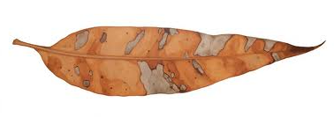
And brown

Slide 6
Falling softly as they do
Over me and over you

